Slide 1
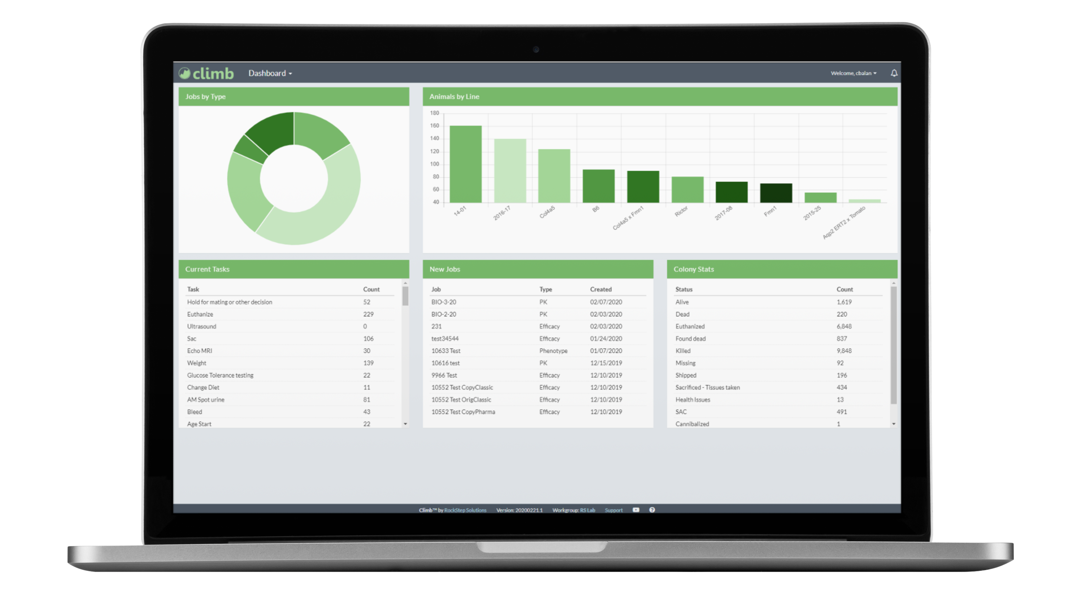
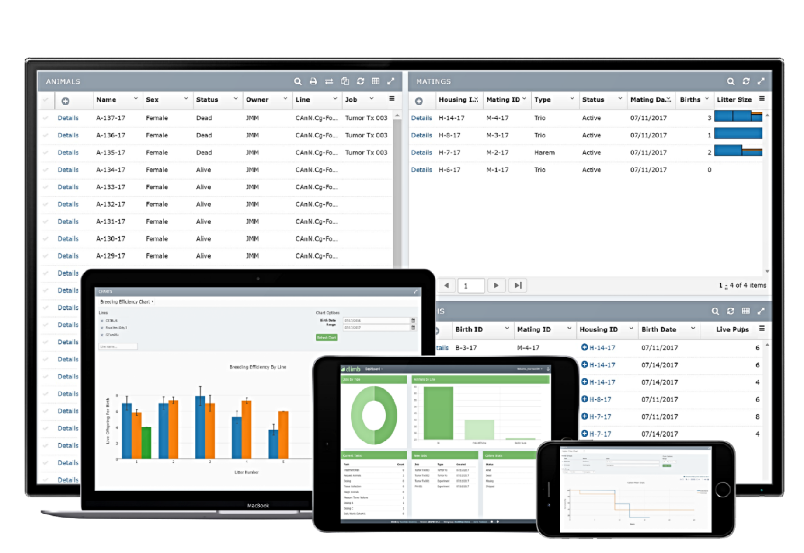
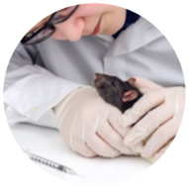
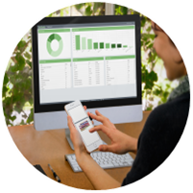
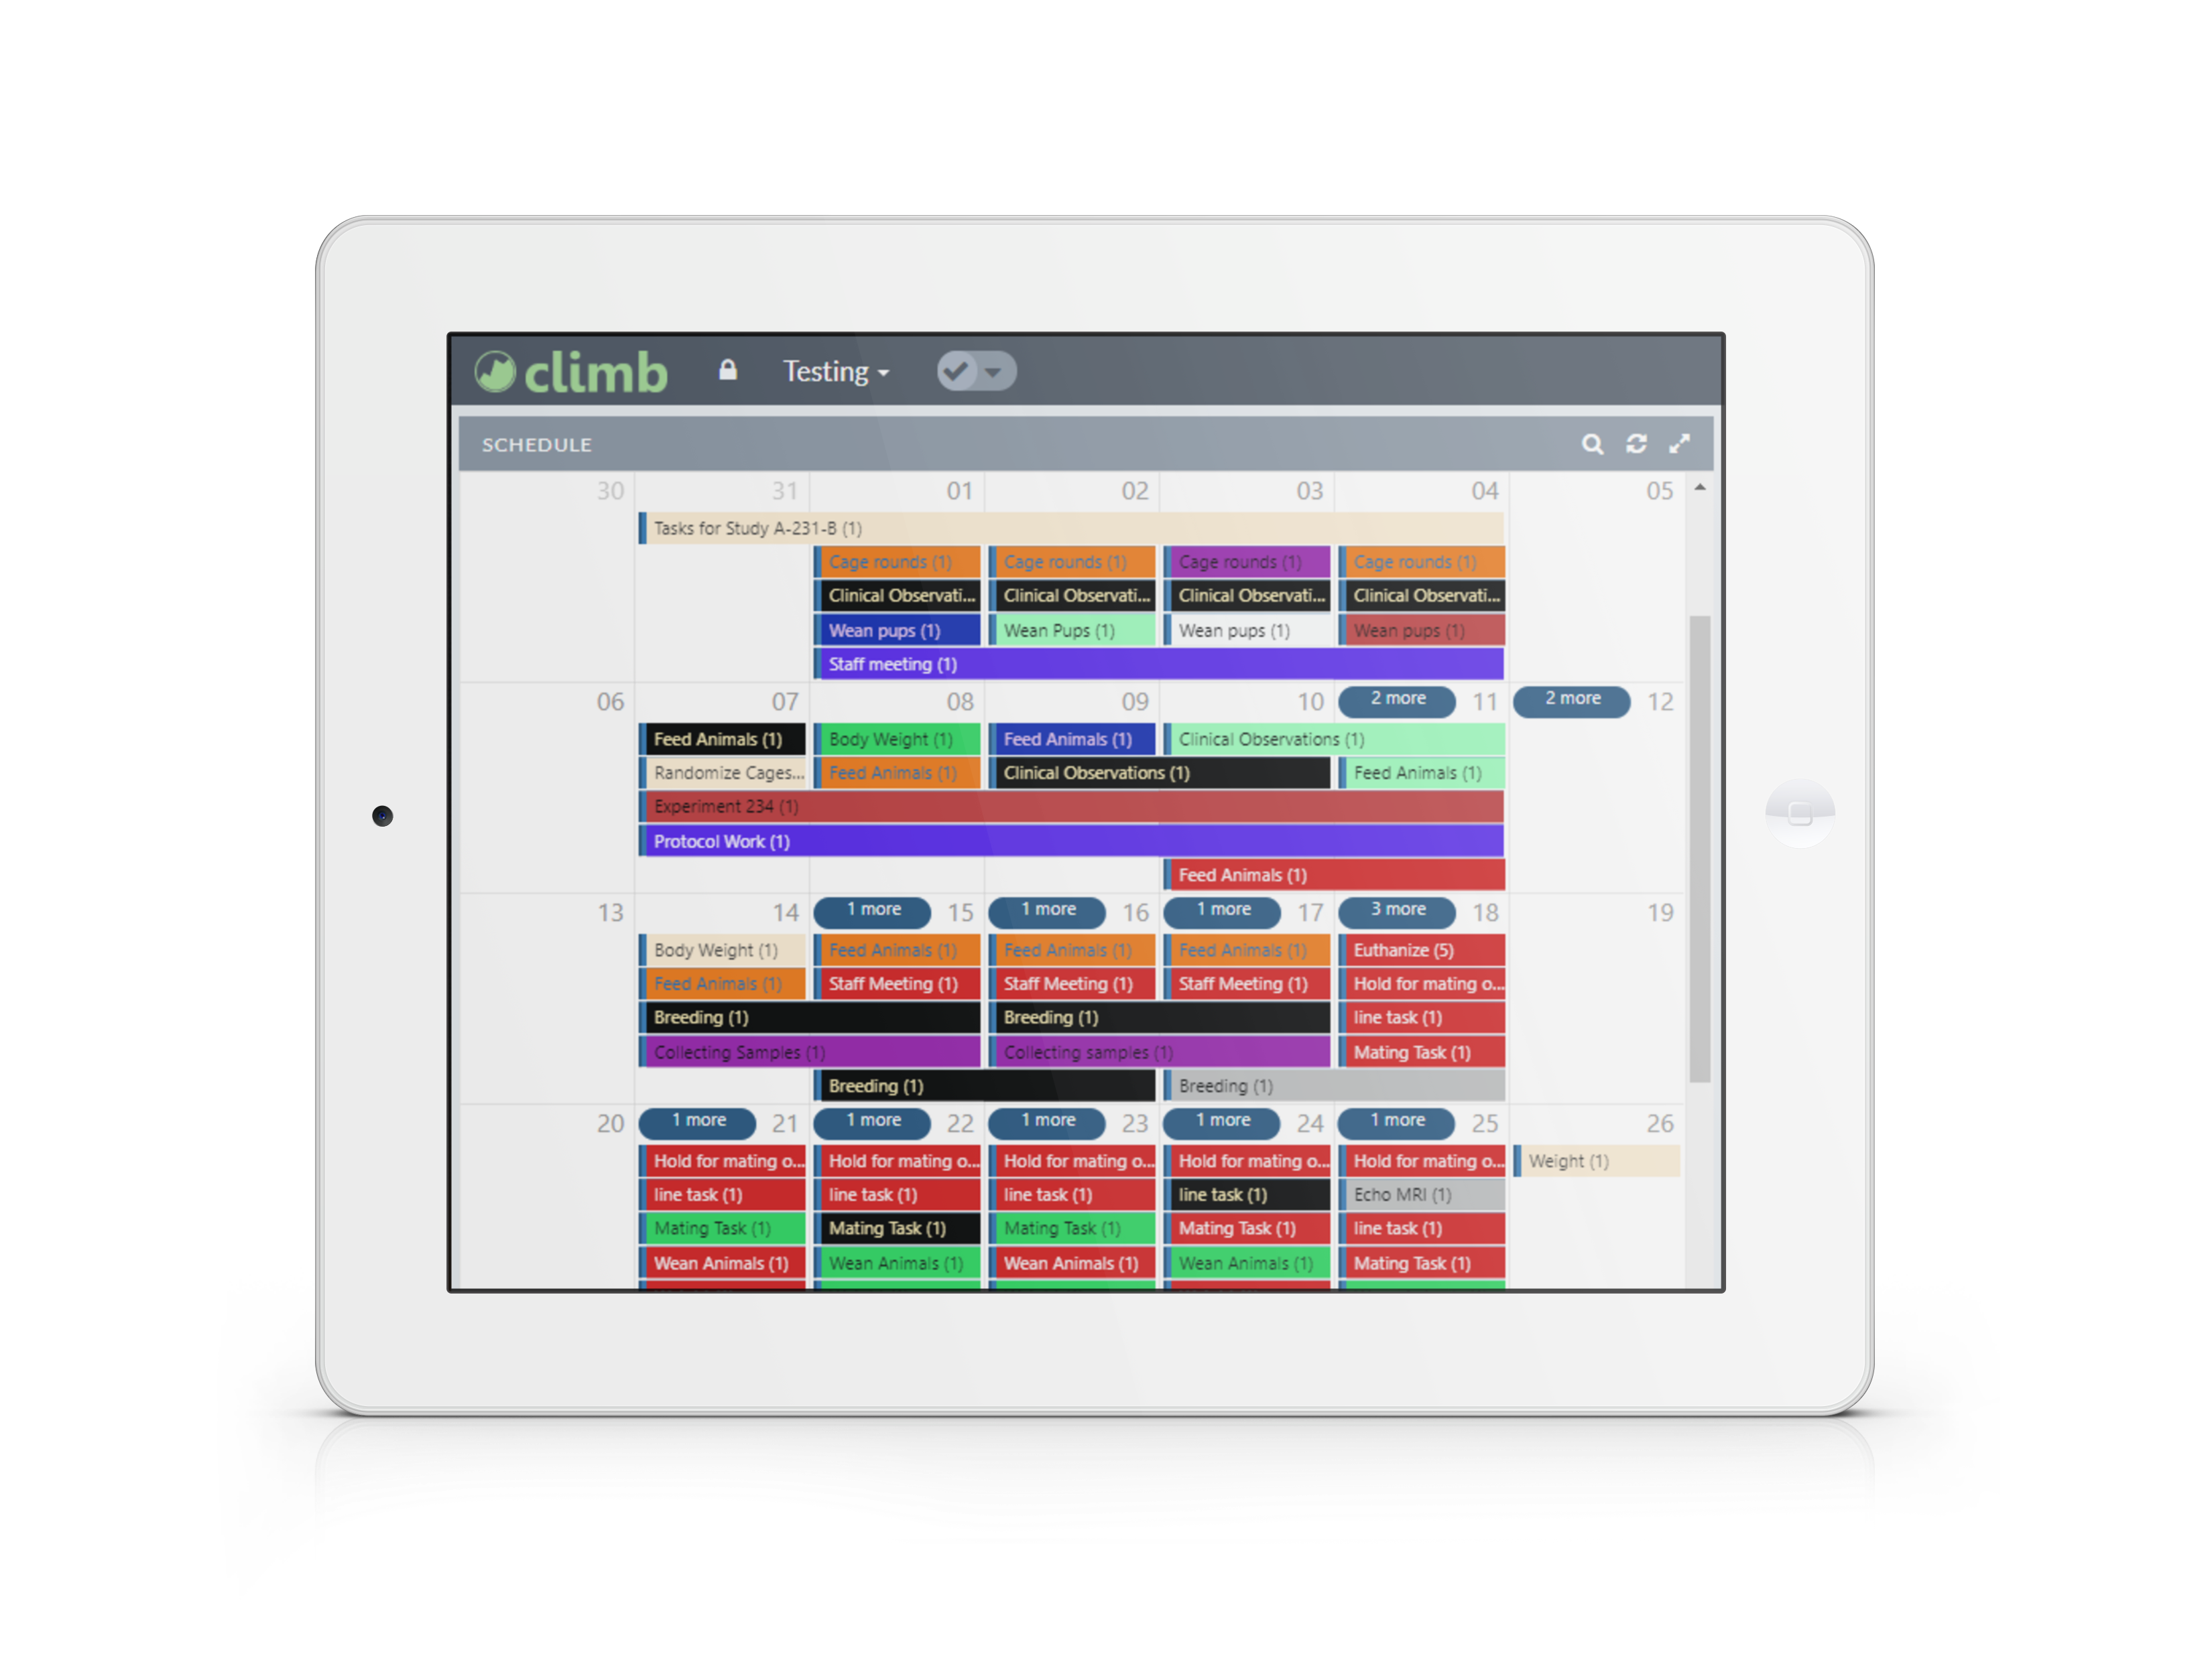
COVID-19 Preparedness
Climb supports social distancing and remote work
Keeping your critical in vivo operations running during a pandemic outbreak
Using Climb to Manage Critical Ops
Climb allows users to continue working remotely
Cloud first born mobile
Animal Welfare
Caring for animals is not optional. Send remote instructions to animal care takers with Climb.
Animal technicians can get their to-do lists for animal welfare checks through Climb
If an animal is observed in destress, technicians can take notes, a photo, or video, drop them into Climb
Climb maintains clinical records that can be viewed by vet staff Treatment plan execution can be monitored in real time
Remote Communication
Climb’s message center is used to communicate messages and leave an audit trail for compliance
Veterinarians diagnose and set up treatment plans remotely via Climb’s clinical facet
Using Climb, treatment plans and clinical records can be used to communicate between technicians and vet staff
Treatment plan execution is monitored in real time
Remote Study Planning and Scheduling
Study directors and lab managers use Climb to schedule resources and track progress
Study teams are tasked remotely via the Climb workflow engine
Studies schedules are easily updated via the Climb scheduling tools
Role Remote Options
Scientist
Study design and progress monitoring
Data retrieval and analysis
Scheduling & tasking, data QC
Receive workflow, instructions, and tasks, communicate with team via in-app messaging
Reviewing health records, setting up and monitoring treatment plans
Systems management and security
Data Analyst
Study Director/ Lab Manager
Lab technician
Data Wrangling for Analysis
Veterinarian
Data captured directly into Climb, no transcriptions
Data Scientists retrieve data remotely from Climb for analysis.
Data scientists have 360 visibility into how tasks are conducted, including timing and notes from technicians
IT
During this COVID-19 crisis, we are here to help research organizations maintain business continuity. Climb™ is ideal for managing all your in vivo operations with safe social distancing to help minimize risk to your staff and your research. RockStep is working with our customers and partners to ensure everyone who needs a solution gets one.
Chuck Donnelly(CEO) & Julie Morrison (President)
www.rockstepsolutions.com
Want to learn more or get more details?

